Slide 1
Marathons and the Normal Distribution
Benjamin Hill

Slide 2
You have been asked to create a short presentation that introduces your audience to marathons and teaches them about patterns in finishing times (the time it takes to complete the marathon). Make sure to introduce the normal distribution to your audience. The normal distribution is an important pattern to understand and could help your audience set goals when running a marathon.
Your presentation should also include descriptions of spatial and temporal patterns in the finishing times. You should look for patterns among individual marathon runners, and patterns between different marathons.

Slide 3
The purpose of this presentation is to introduce the audience to marathons and use the normal distribution to show some things that can be expected for a given marathon runner to experience.
A marathon is a running competition where the athletes run 26.2 miles, approximately the distance between ancient Marathon and Athens. Such events bring in tens of thousands of competitors every year.

Slide 4
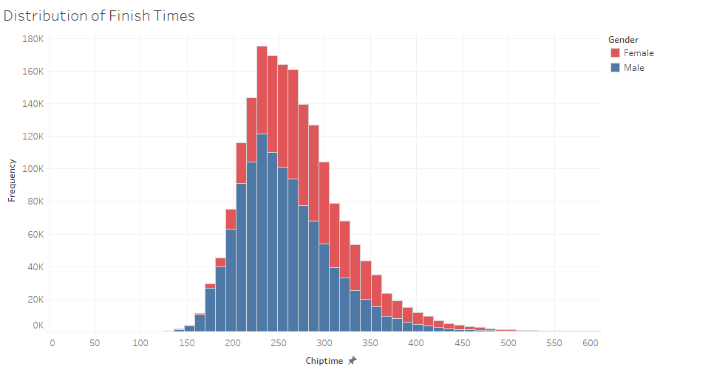
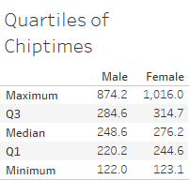
Below is an example of a normal distribution, which is a bell-shaped distribution. This distribution of chiptimes (time to complete the marathon, in minutes) is slightly right-skewed, but it is very nearly normal. This represents runners from all marathons worldwide in 2010.

Slide 5
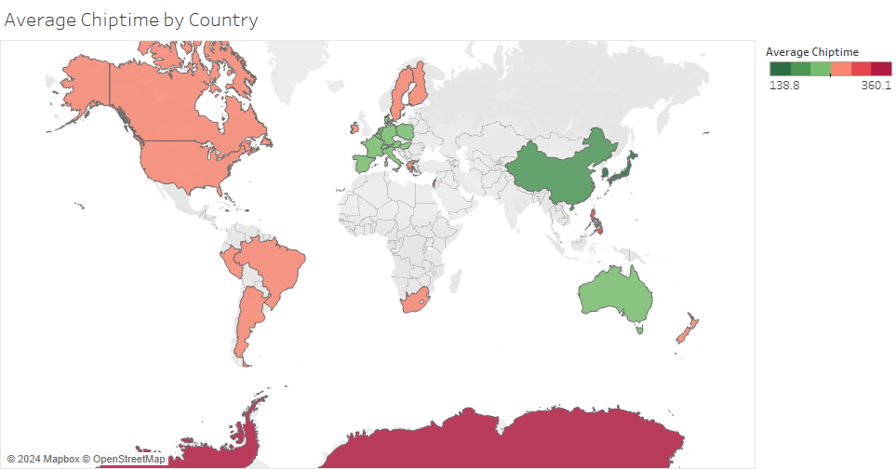
The following chart shows the average chiptimes of marathons that took place in each country recorded, and there is a striking difference between the East and the West. Some of that difference can be explained on the next slide.

Slide 6
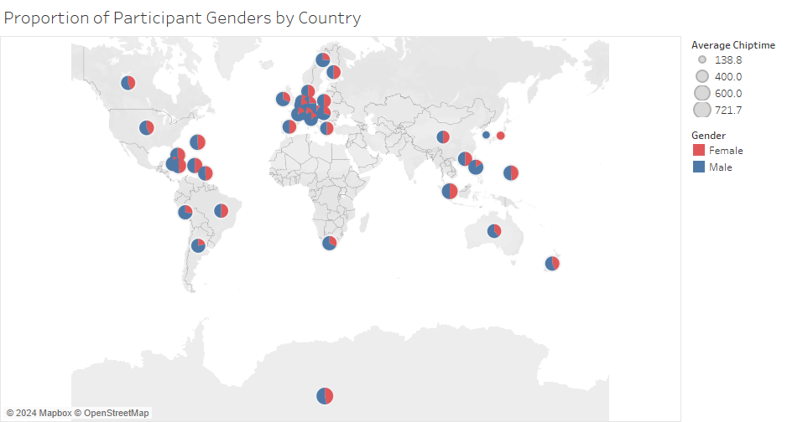
The lowest chiptimes shown in the previous chart were from Japan and South Korea, and those countries also had the lowest numbers of runners. This indicates that the runners participating in those marathons were a few very well-trained athletes. The marks on the countries also serve as pie charts showing the proportions of the genders of the participants.

Slide 7
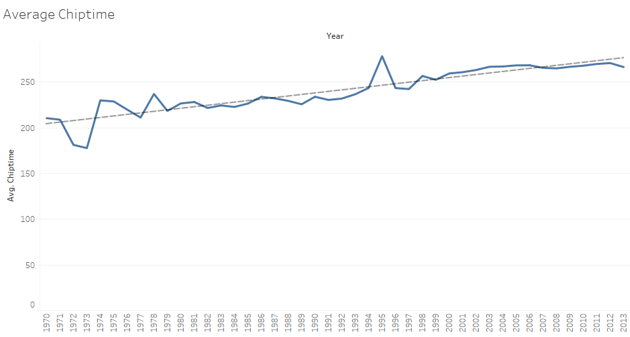
This graph shows an interesting trend in chiptimes, with the average steadily increasing over the decades. This means the runners have become slower over time, on average. We will explore this situation further.

Slide 8
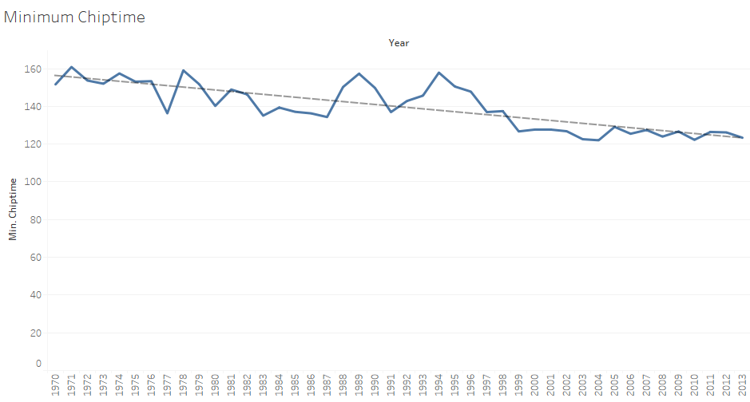
This graph shows the minimum chiptime over the years, instead of the average, and it is steadily decreasing despite the increase of the average. This implies that some athletes are steadily breaking records of speed while other runners are doing far worse, dragging out the average.

Slide 9
This increase in average chiptime and seeming decrease in the quality of runners could be due to the rising popularity of marathons, which attracts many more new runners who are not as experienced or well trained. Another reason could be that some of the same runners are still running marathons in their old age, so their chiptimes are much larger than they once were. I feel these two reasons together explain the increase in chiptime.

Slide 10
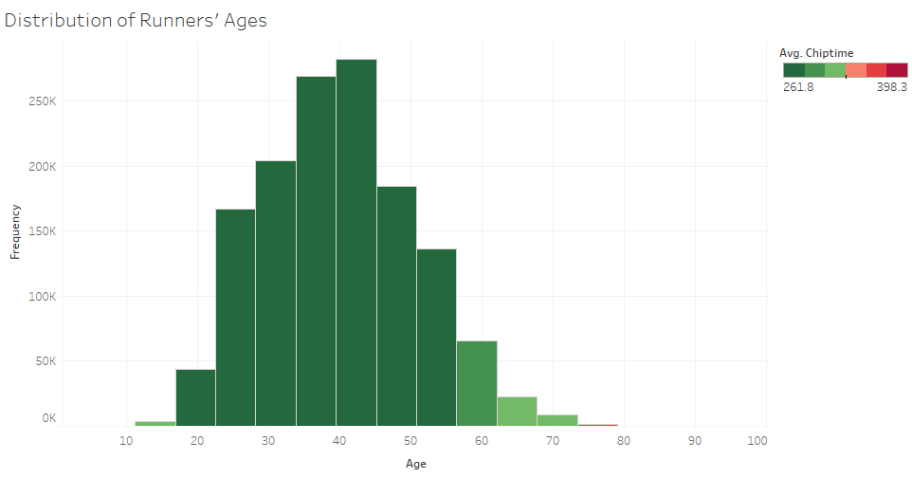
This graph shows distribution of the ages of runners, colored according to the average chiptime of that age group. Some runners are even in their 90s! Their chiptimes were very high, for obvious reasons.

Slide 11
It might also be interesting to explore the affect of elevation on chiptimes. The following charts seem to give no indication that elevation changes chiptime appreciably.

Slide 12
